Slide 1


The U.S. Home Video Game market : analysis
Digital economic approach
Chiara Daini and Vina Panduwinata
Based on Gallagher and Ho Park article, written in 2002

Slide 2

What was once an activity enjoyed alone or with a small group of friends has been able to reach millions of users
across the world.
01
GAME INDUSTRY HAS MADE IT POSSIBLE TO CONNECT EACH PLAYER, EVEN IF THEY LIVE ON THE OTHER SIDE OF THE WORLD.

Slide 3
Competitive dynamics in a standard-based industry through a historical observation of the U.S. home video game industry.
02
Multiple stages of technological innovations, changes of market leadership and industry standards during a relatively short history of the industry.
Six generations of technological changes in video game consoles and complementary products, with each generation represented by a new set of competitors, dominant designs, and market leaders out-competing the leaders of the prior generation.

Slide 4


> FOCUS
03
DOMINANT DESIGN
PRODUCT VERSIONING
SWITCHING COST
INSTALLED BASE
COMPLEMENTARY GOODS
NETWORK EFFECTS

Slide 5

Dominant design
The product architecture that first embodies all the primary characteristics of later products.
04
Installed Base
Product versioning
Existing number or users of a product.
New inventions, technologies or strategies behind the creation of products and services.
Complemetary Goods
Switching Cost
Are those products that are needed to maximize the utility of the core product.
Costs customers incur moving from one product to another. Once a dominant design emerges, creating switching costs becomes a central feature of competition in standard based industries.
Network Effect
Need for interconnectedness where customers become relatively more “locked in” to a standard.
Theoretical Focus

Slide 6
1st Generation : (1972-1982)
05
Pong Pong, an e-version of tennis, was invented by Atari in 1972.
The game became widely popular such that Atari wasn’t able to cover the demand.
In the late 1976, Fairchild Instrument and Camera introduced a system with replaceable cartridges, which offers a potentially infinite number of games.
Atari followed quickly the dominant design which Fairchild imposed and, thanks to the capital infusion of Warner, produced enough VCSs (later named 2600) to cover the demand for 1977.
In 1979 Atari purchased the license for Space Invaders and become the most popular video game platform with a 80%-90% between 1979 and 1981.

Slide 7

> FOCUS
06
INCUMBENT FIRM
ADAPTED VERY FAST THE NEW DESIGN WHICH BECAME EVENTUALLY DOMINANT
STRONG NETWORK EFFECT
Atari

Slide 8
2nd Generation : (1982-1986)
07
1982 is the beginning of the end of Atari.
Users start to drop out and the value of network decreases for those who stay.
price
For those who stay, price become higher than the benefits and so they decided to leave and to choose another supplier.
Network failure.
% market served

Slide 9
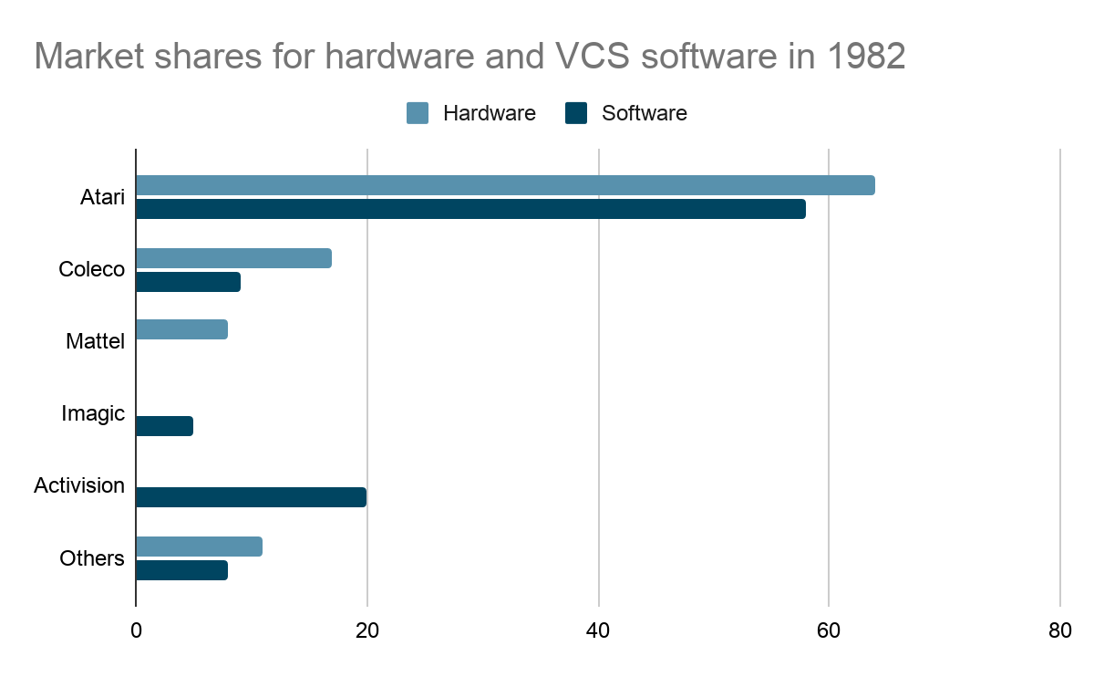
2nd Generation (reason of Atari failure) :
08
Mattel’s intellivision came into the market in 1980. Its games, sounds and graphics were clearly superior compared to the ones of Atari. Coleco license an arcade game called Donkey kong, in 1982, from the japanese firm Nintendo, specialized in toys, card and video games. A copy of this game was included in every consolle Colecovision.
Coleco, moreover, distribute an adapter that allowed Colecovision to play with every Atari’s VCS games.
Adapter sales never were very high but it helped to cut out Atari from the market and its advantage to having a larger library.
Complementary good, such as the adapted, help Coleco to gain in less than a year 17% of the market, compare to its competitors did previously.

Slide 10
2nd Generation :
2nd Generation (reason of Atari failure) :
09
A serious competition arises in 1982, after Atari allowed other firm to produce VCS cartidge in exchange of a small fee. Eventually 28 new entrants started to produce Atari’s cartidge.
Moreover, the fact that many company entered in the market, and alll of them proposing substitute goods, make the market collapse and generate tremendous industry-wide losses and exit of several major competitors.
Atari experience tell us that even if a firm is the standard setting and build standard base alone, this is not sufficient to maintain the dominance in the market.
Manufacturer | Model | Price (1/1/1983) | Price (31/5/1983) | Price Change
Atari | VCS/2600 | $139 | $99 | %29
Coleco | Colecovision | $199 | $139 | %30
Mattell | Intellivision | $199 | $139 | %30
Notes:
Compatibility across systems and platforms increases utility for users but create a ‘trade off’ for suppliers: increases the probability of adoption but increases the competition in the market.

Slide 11


> FOCUS
10
NEW ENTRANTS
IMPORTANT ROLE OF THE COMPLEMENTARY GOODS RELATED TO THE MAIN PRODUCT
PRICE COMPETITION
SUBSTITUTE PRODUCT
Coleco - Mattel

Slide 12
3rd Generation : (1986-1989)
11
After the U.S. market collapse, in 1986 Nintendo Entertainment System (NES) is released. It had a more realistic graphics than the earlier systems and it had a great success in Japan.
Nintendo designed a much more rationalized approach than the other firms previously in the market. Nintendo strategic points were :
Included lock out chip to prevent unauthorized licensed.
Limited the license into 16 firms
Gain a monopoly power because of exclusive deals with software makers
Prevent companies from flooding the market with “copycat” and assured people that they have their best game to released
Tightly control complementary products
05

Slide 13
3rd Generation : (1986-1989)
12
First competitor: Atari and Co. that introduced the version of 7800 which never caught on due to its low quality graphic.
NINTENDO TECHNOLOGICAL INNOVATION
Second competitor: Sega introduced Master System, technologically similar to NES, but Nintendo owned the majority of the licences for video games and Sega had trouble to access to the distribution network.
NINTENDO ENTRY BARRIERS AND NETWORK EFFECT
05

Slide 14
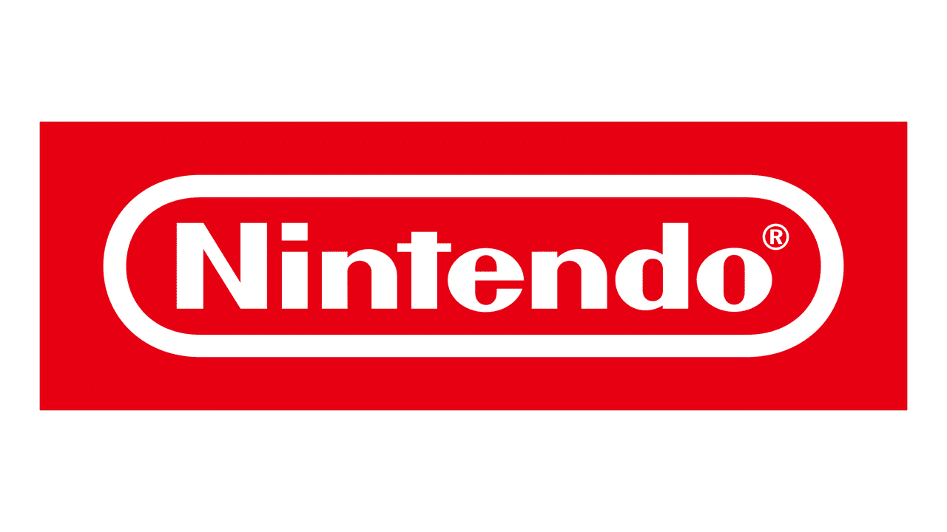
> FOCUS
13
FIRST MOVER
TECHNOLOGICAL INNOVATION
COMPLEMENTARY GOODS
STRONG ENTRY BARRIER - RATIONALIZED APPROACH TO THE MARKET
VERSIONING
Nintendo

Slide 15
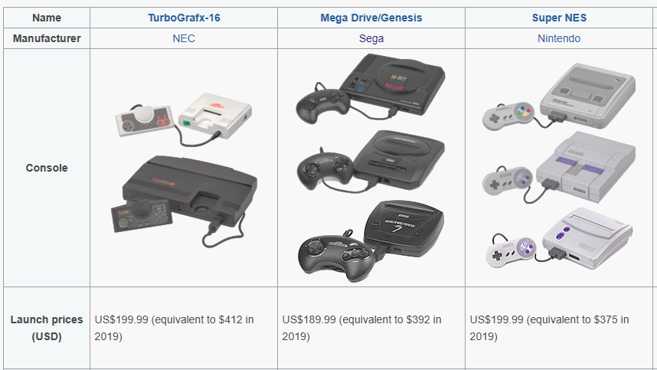
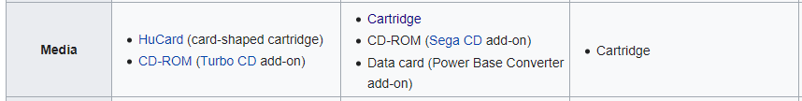
4th Generation : (1989-1996)
A new entrant enter the market. Sega and NEC introduced the Sega Genesis System and the Turbo Grafix-16 system, leaving the 8 bit NES with improvement in graphical colors and digital sound, but the sales did not approach the sales of Nintendo, because Nintendo had more variant for the game titles.
14
07
Source : WIKIPEDIA

Slide 16

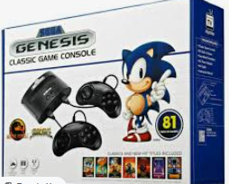
> FOCUS
15
ENTRY TIMING
COMPLEMENTARY GOODS
PRICE COMPETITION
PRODUCT VERSIONING : LOWER COST AND HIGH MEMORY BY USING CD
NETWORK EFFECTS : POPULARITY OF THE GAME CHARACTER
Sega

Slide 17
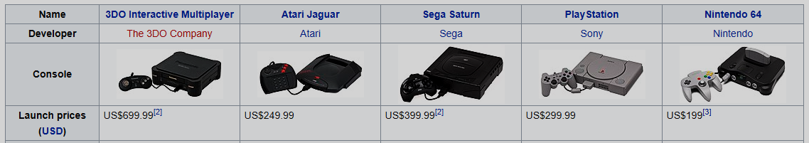
5th Generation : (1995-2002)
16
A 32 bit system had introduced to the market, called the Interactive Multiplayer (IM).
Innovation in this era played an important role for new challengers in game industry. Sega successfully entered the market with complementary products. Sony expanded installed base by decreasing the price of core products, while 3DO had no willingness to cut the cost for IM, so their product failed.
08
Source : WIKIPEDIA

Slide 18

> FOCUS
17
COMPLEMENTARY GOODS RELATED TO THE MAIN PRODUCT
PRICE COMPETITION
INSTALLED BASE : EARLY ADAPTOR
DOMINANT DESIGN
Sony

Slide 19
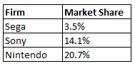
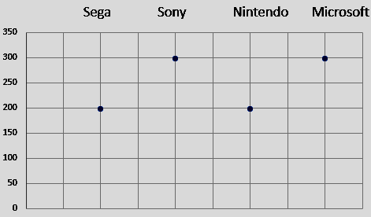
6th Generation : (1999-2004)
18
Sega introduced its 128 bit Dreamcast system, but in 2001, Sega discontinued its manufacturing for Sega Dreamcast
Microsoft with X-Box based on technology from pc industry as new entrant
Price comparison
09

Slide 20

> FOCUS
19
ENTRY TIMING
COMPLEMENTARY GOODS RELATED TO THE MAIN PRODUCT
PRICE COMPETITION
PRODUCT VERSIONING
COMPATIBILITY
Microsoft

Slide 21


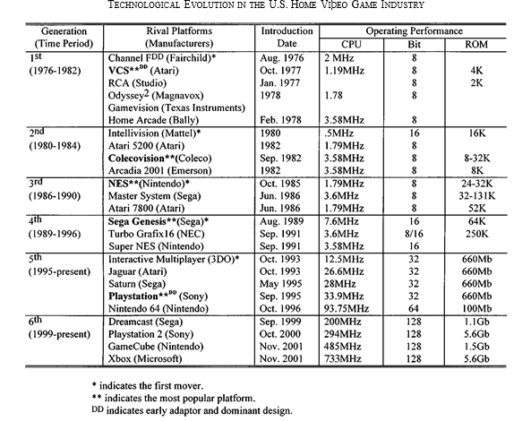
20

Slide 22

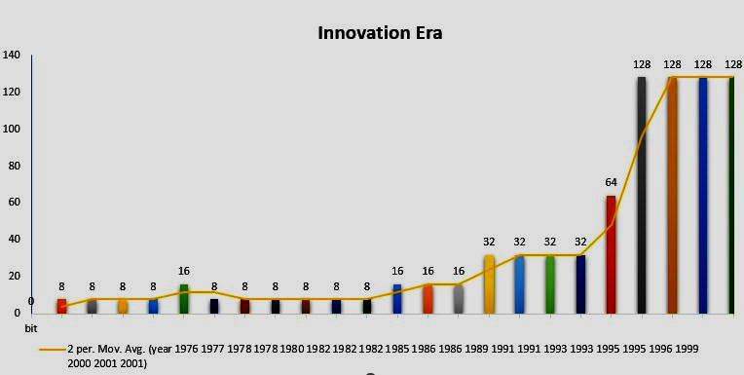
Products versioning in machine bits
Performance in gaming industry in various versioning of the products provide price competition with leadership. The leader also prevent the software to be adopt by another firms with the presence of contractual clauses to standardize their products.
21

Slide 23

The success and failure of gaming industry
22
From the figure, we can see that in 1980, Intellvision released an innovation of 16 bits, there was an evolution for performance, digital sound and graphic color in gaming industry. Why they couldn’t be a dominant player along this period?

Slide 24
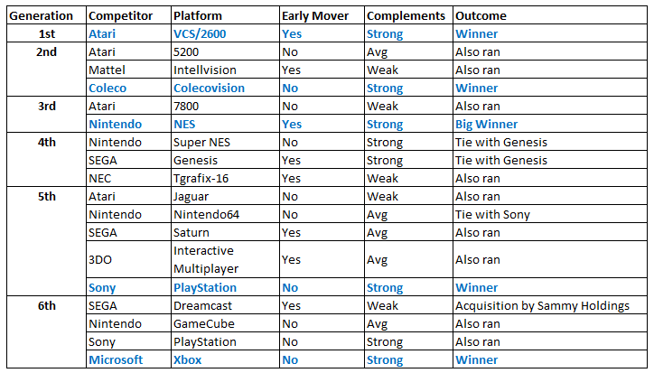
The success and failure of gaming industry
23

Slide 25


Direct Network Effect
24
Definiton : static effect of adding a new user to an existing network of users.
Direct network effect caused by : superior technology, the value/preference of existing user to potential customers, early entry through innovation, proper pricing to create willingness to pay, name brand, channel management, entry barriers.

Slide 26

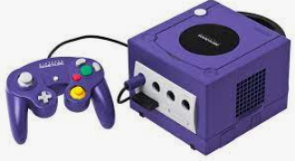
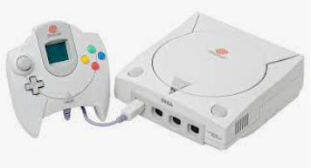
25
Problem in
Direct Network Effect : one of the high entry barriers
Compatibility product
Firms should be considering their release time for a new product, and also the technology among their innovations. The lock out of industry caused by these 3 main reasons :
a) no backward compatibility between core products;
b) subsidized costs of core products;
c) very low intangible customer switching costs.
Case Nintendo and Sega Dreamcast in 6th Generation
GameCube
Dreamcast

Slide 27


26
INDIRECT NETWORK EFFECTS
The presence of complementary products, when the industry created connectivity between software and hardware.
The easiness to get the complement of the core products, is the key factor to maximize the utility of the core products and lower the switching costs.

Slide 28
Conclusion:
Without the power of any big name, the business can not gain sustainable profit
Firms who had power might be as a follower, the power will not lasting forever, it can change along with time.
A bad decision in enter the market with new product will affect to the crisis of the company.
The combination of new entry and complementary products led to losses and failure for several competitors.
To have sustainable market especially with variety of consumers, firms have to innovate actively also they have to prevent cannibalization of their products.
Price discrimination, product differentiation and versioning, networks effect are important as the strategy to gain the market power.
27

Slide 29
THANK YOU
Source :
https://www.researchgate.net/publication/3076707, IEEE Transactions on Engineering Management · March 2002
WIKIPEDIA
Image from GOOGLE
Slides from EDS lessons by Prof. Roberto Fontana
Template from canva.com

